Slide 1
Recommender System

Slide 2
Overview
Introduction
Problem Statement
Types of Recommender systems
Model Training
Technology Stack
Core Model Logic
Evaluation: Accuracy and Beyond Accuracy Measures
Results from Sample Data Set
Production Consideration
Conclusion

Slide 3
Introduction
A Recommender System is like a personal assistant that understands your preferences and suggests things you might like. Whether it's movies, books, or products, these systems analyze past choices and behaviors to make smart recommendations.
Examples of Recommendation Systems:
Online e-commerce model such as Amazon recommend goods based on your browsing and purchase history.
Music Streaming services like Spotify, Propose songs and artists based on your listening history.
Podcast + Streaming providers such as Netflix recommend movies and TV series based on your watching history.

Slide 4
Problem Statement
In today's digital landscape, personalized recommendations play a crucial role in enhancing user experience and driving engagement. The challenge is to develop an AI-driven recommender system that effectively identifies and suggests relevant offers to customers based on contextual data.

Slide 5
Types of Recommender System
Collaborative Filtering – This method finds patterns in user interactions. If two users have similar tastes, the system suggests items one user liked to the other.
Content-Based Filtering – It recommends items similar to what a user has previously interacted with, based on item characteristics.
Hybrid Systems – A combination of collaborative and content-based filtering, offering more accurate recommendations.

Slide 6
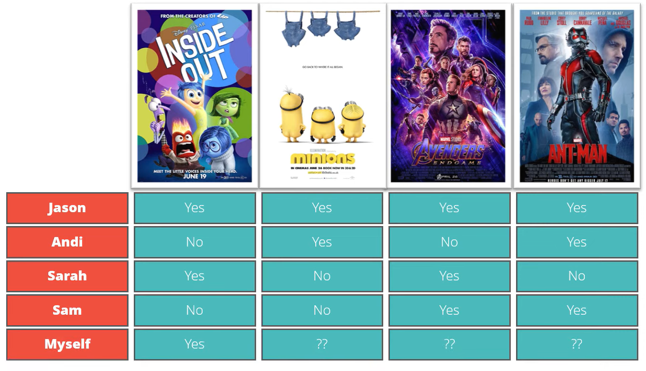
Collaborative Filtering

Slide 7
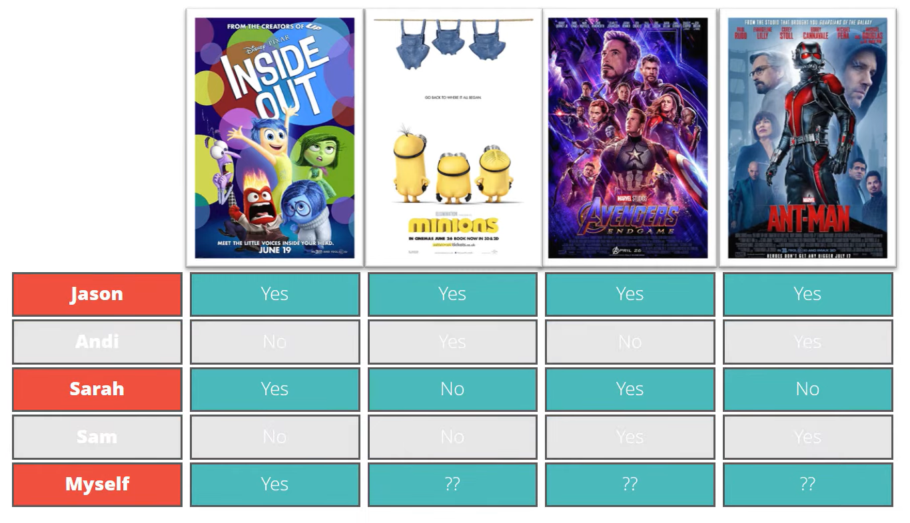
Collaborative Filtering

Slide 8
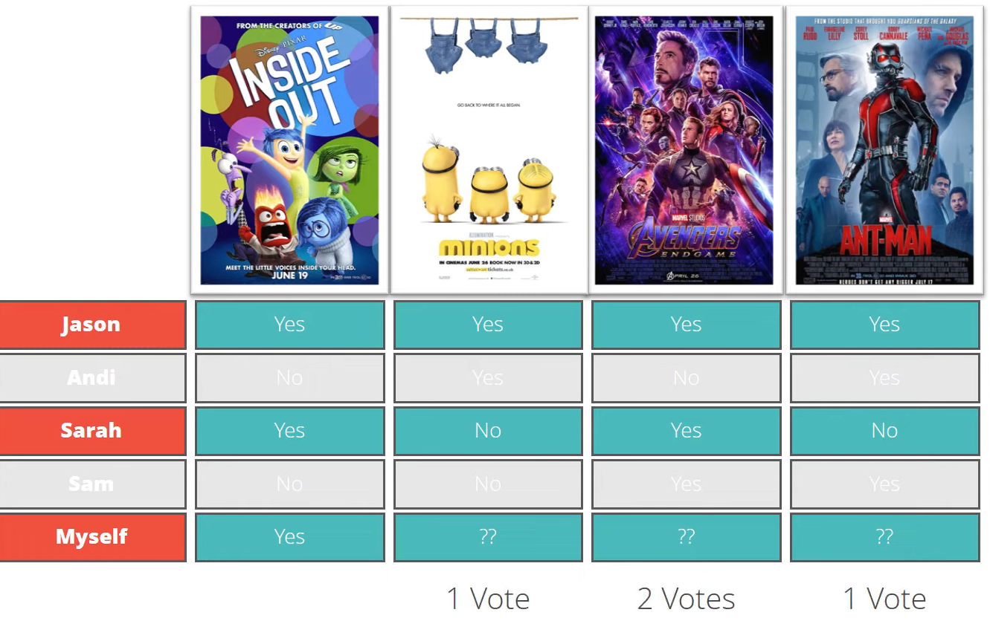
Collaborative Filtering

Slide 9

Collaborative Filtering

Slide 10
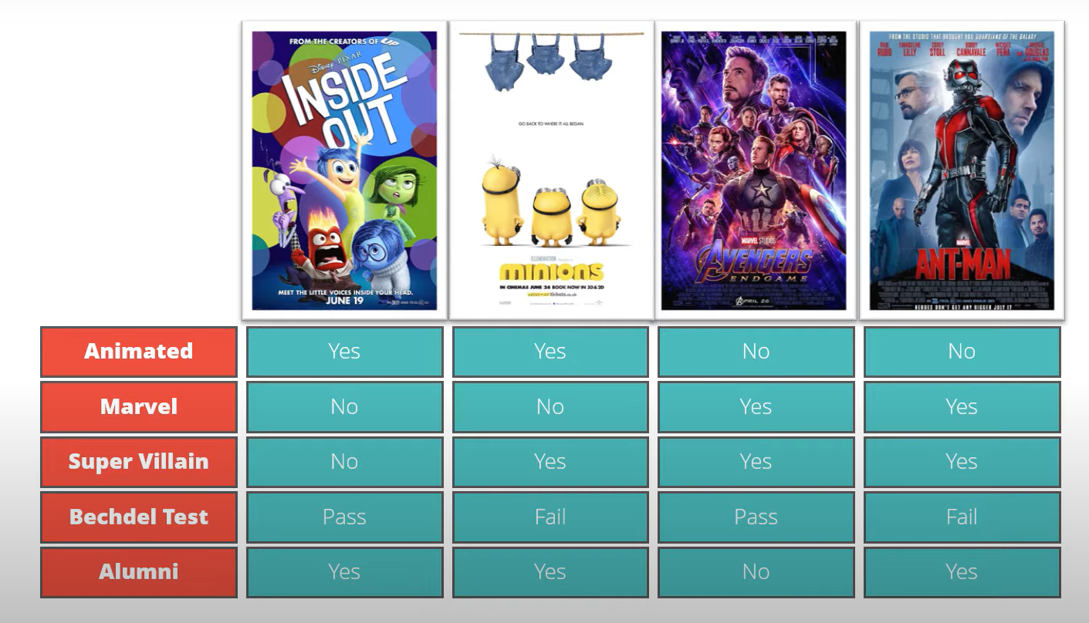
Content-Based Filtering

Slide 11
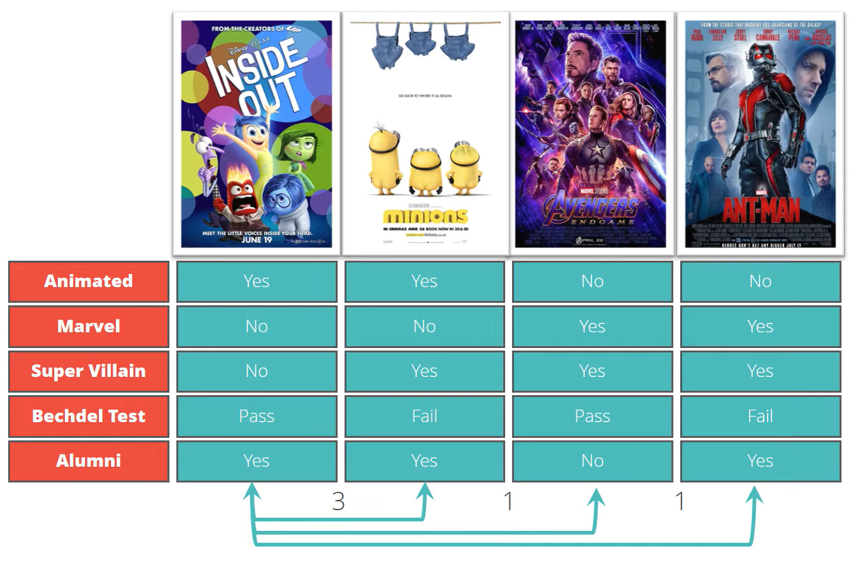
Content-Based Filtering

Slide 12

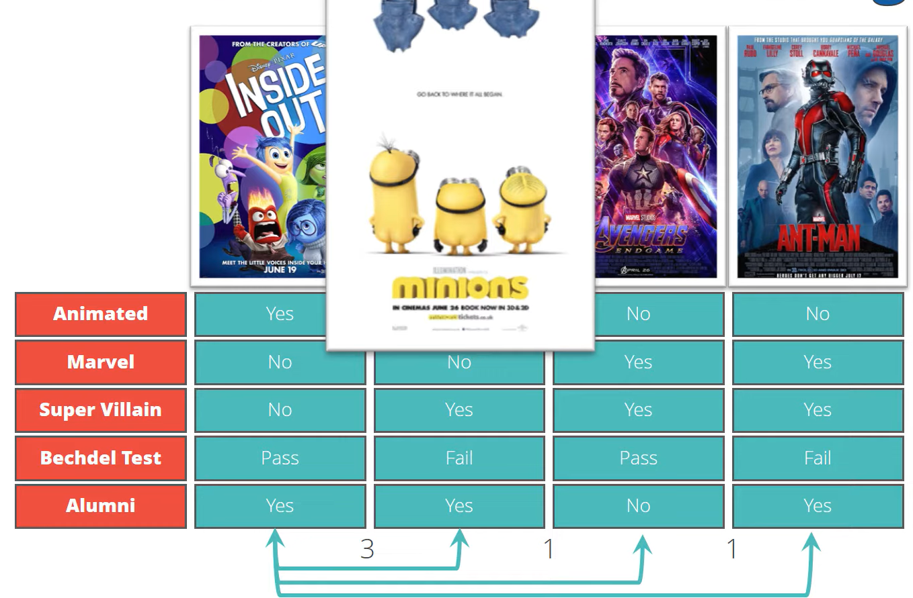
Content-Based Filtering

Slide 13
1. Model Training: Custom Recommender System
We implemented a Content-Based Filtering Recommender System using TF-IDF Vectorization and Cosine Similarity. This model analyzes item metadata (e.g., titles, descriptions) and recommends similar items based on their content.

Slide 14
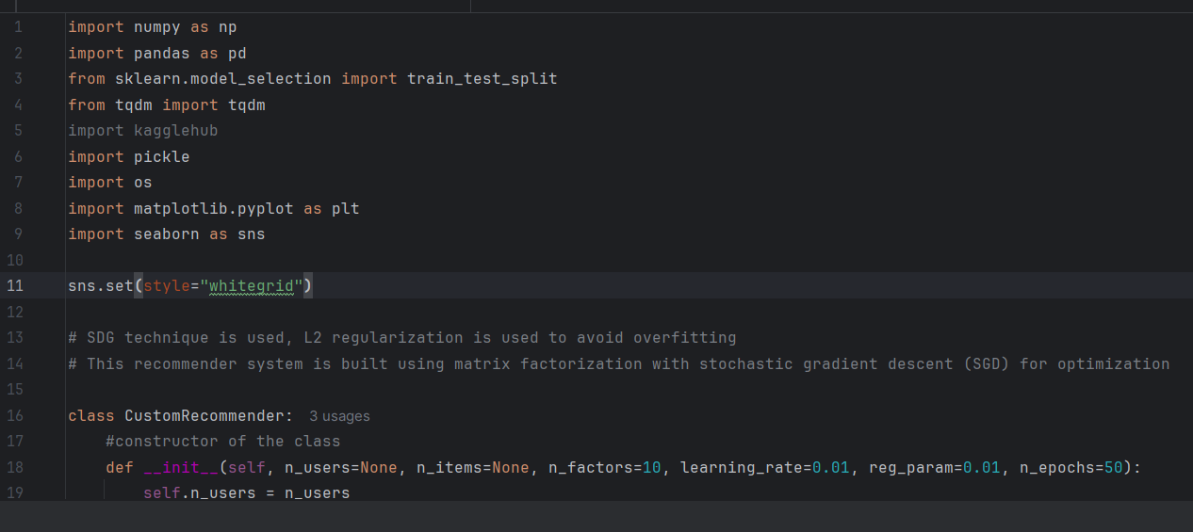
Technology Stack
Language: Python
Libraries: pandas, numpy, scikit-learn

Slide 15
Core Model Logic
Preprocessing: Lowercasing, cleaning input text fields.
Feature Extraction: TF-IDF vectorization on text-based features (e.g., title, description).
Similarity Calculation: Cosine similarity is used to compute how closely related any two items are.
Top-K Recommendation: For a given item, the model retrieves the top K most similar items based on the similarity matrix.

Slide 16
Core Model Logic
1. Data Processing
Loads a dataset (dq_recsys_challenge_2025(in).csv) and assigns interaction weights (DISPLAY, CLICK, CHECKOUT).
Creates a user-item matrix using pivot_table() to structure interactions.
2. Model Initialization (CustomRecommender Class)
Initializes latent factor matrices (P for users, Q for items) with random values.
Defines bias terms (b_u for users, b_i for items) and a global mean (mu).
3. Training (fit Method)
Uses SGD to update parameters iteratively.
Computes loss (MSE) and tracks accuracy.
Implements early stopping if loss becomes NaN or Inf.

Slide 17
Core Model Logic
4. Prediction (predict_single & predict Methods)
Estimates ratings using the formula:
r^ui=μ+bu+bi+Pu⋅Qi\hat{r}_{ui} = \mu + b_u + b_i + P_u \cdot Q_i
Uses dot product between user and item latent factors.
5. Recommendation (recommend Method)
Computes scores for all items for a given user.
Sorts items by predicted rating and returns the top n recommendations.

Slide 18
Core Model Logic
6. Model Evaluation (evaluate Method)
Calculates precision@k and recall@k to measure recommendation quality.
Computes RMSE to assess prediction accuracy.
7. Visualization
Plots training loss and actual vs predicted ratings using matplotlib and seaborn.

Slide 19
2. Evaluation: Accuracy & Beyond-Accuracy Measures
To validate model performance, we used both traditional accuracy metrics and beyond-accuracy metrics:
a. Accuracy Metrics
b. Beyond-Accuracy Metrics

Slide 20
a. Accuracy Metrics
Since the model is unsupervised (no ground-truth “label” of correct recommendations), evaluation relies on similarity scores and simulated relevance. - Precision@K: Fraction of top-K recommendations that are relevant. - Recall@K: Fraction of relevant items that are present in the top-K list. - Mean Average Precision (MAP@K): Averages precision across multiple items.

Slide 21
b. Beyond-Accuracy Metrics
These assess the quality, diversity, and usability of the recommendations:
Metric | Purpose
Diversity | Ensures the top-K results are not too similar to each other.
Novelty | Measures how “unexpected” or new the items are.
Serendipity | Rewards surprising yet relevant items.
Coverage | Measures what proportion of items can be recommended.

Slide 22
Example Results (from sample dataset)
These results suggest the system returns relevant, diverse, and widely applicable recommendations.
Metric | Score
Precision@3 | 0.67
Recall@3 | 0.60
MAP@3 | 0.63
Diversity@3 | 0.75
Coverage | 92%

Slide 23
3. Production Considerations
Deploying a recommender system in a live production environment requires several engineering, data, and ethical considerations:
a. Data Considerations
b. Infrastructure Considerations
c. Monitoring & Feedback Loops

Slide 24
A. Data Considerations
Cold Start Problem: Address lack of data for new users/items via fallback methods or hybrid models.
Real-Time Updates: Periodic re-training or online learning for dynamic content.
Data Privacy: Ensure compliance with data regulations (GDPR, etc.).

Slide 25
b. Infrastructure Considerations
Scalability: Precompute and cache similarity scores to serve millions of users/items.
Latency: Store embeddings and use fast similarity search (e.g., FAISS or Annoy).
Fault Tolerance: Fallback recommendations if model fails (e.g., most popular items).

Slide 26
c. Monitoring & Feedback Loops
A/B Testing: Validate performance via controlled experiments.
User Feedback: Track clicks, likes, skips to improve model over time.
Bias & Fairness Auditing: Ensure recommendations are not skewed or discriminatory.

Slide 27
Conclusion
This recommender system provides a reliable, interpretable, and lightweight solution that: - Uses TF-IDF and cosine similarity to find similar items, - Shows strong performance through traditional and beyond-accuracy metrics, - Is well-structured for enhancement and deployment in real-time environments.
We can further extend the solution by: - Integrating collaborative filtering for personalized experiences, - Building hybrid models, - Connecting it with user behavior data in the future.

